Slide 1

PROJECT ON ANALYTICS
created by Ritik Kumar

Slide 2
Problem Statement
Nitin works as a Graphic Designer in a new company. He earns Rs 15,000/- per month. He is planning to buy a scooter for his daily commute to the office.
For the last couple of months, Nitin is not able to save at all for his scooter. His friend Ayush told him that he needed to figure out where most of the money goes and cut down that expense.
Help Nitin increase his savings by removing some unnecessary expenses.

Slide 3
Expense Details for the month of June

Slide 4
Sum of June Expenses
Category
Sum of Expense (INR)
Doctor and Medicine
450
Entertainment
1000
Food
850
Grocery
4690
Miscellaneous
500
Shopping
3500
Ticket and Bills
2570
Grand Total
13560

Slide 5
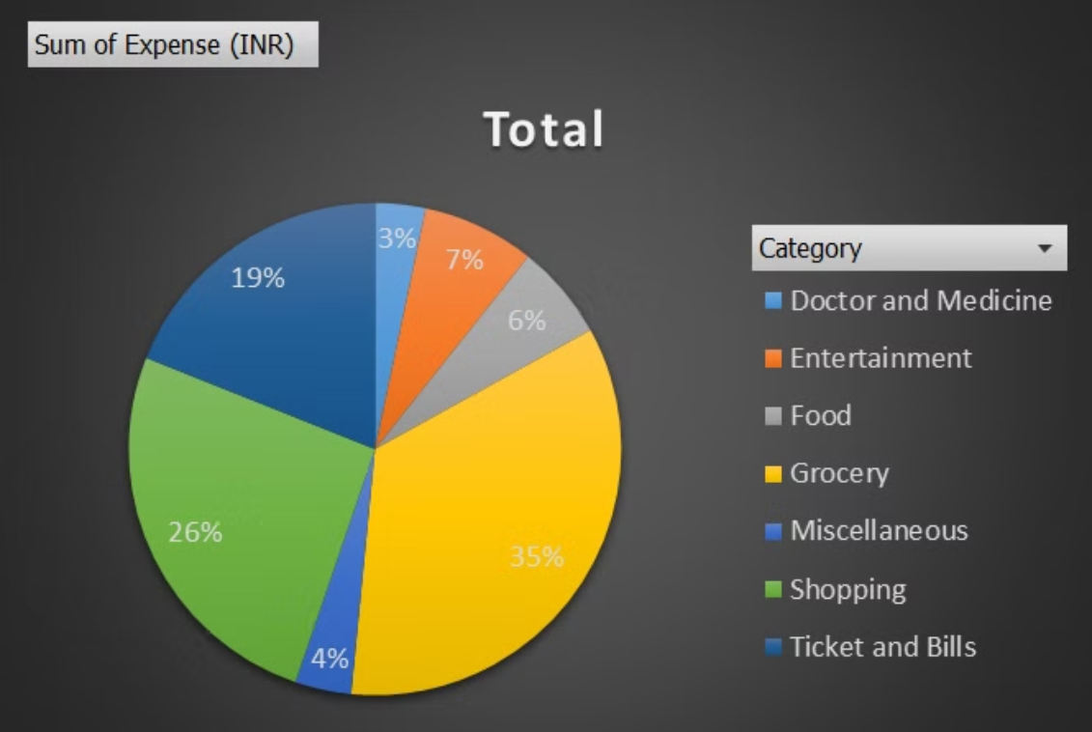
Visual Representation

Slide 6
Total expense amount against entertainment and shopping.
Category
Sum of Expense (INR)
Entertainment
1000
Shopping
3500
Grand Total
4500

Slide 7
Number of times Nitin has ordered food online and the amount spent for it
Items
Count of Items
Sum of Expense (INR)
Online Food Order
4
600
Grand Total
4
600

Slide 8
Number of times Nitin has watched a movie
Items
Count of Items
Movie
4
Grand Total
4

Slide 9
The less essential category that Nitin may remove to increase his savings
Items
Sum of Expense (INR)
Chips and Fries
250
Movie
1000
Online Food Order
600
Tshirt and Jeans
2500
Grand Total
4350

Slide 10
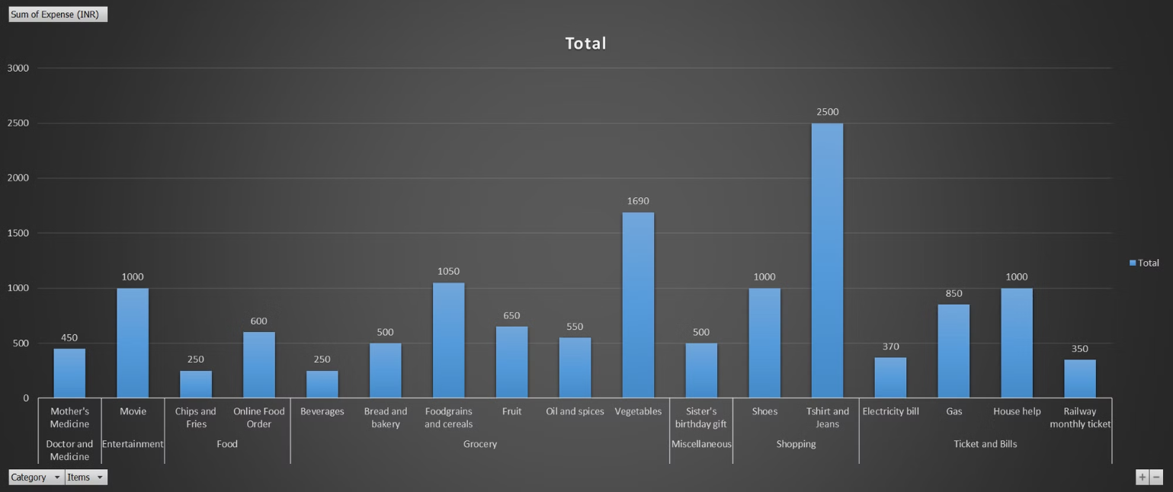
Visual Representation

Slide 11
Expense Details for last 6 months

Slide 12
The month-wise trend of expenses
Months
Sum of Expense (INR)
January
13900
February
15620
March
13140
April
14800
May
13370
June
13560
Grand Total
84390

Slide 13
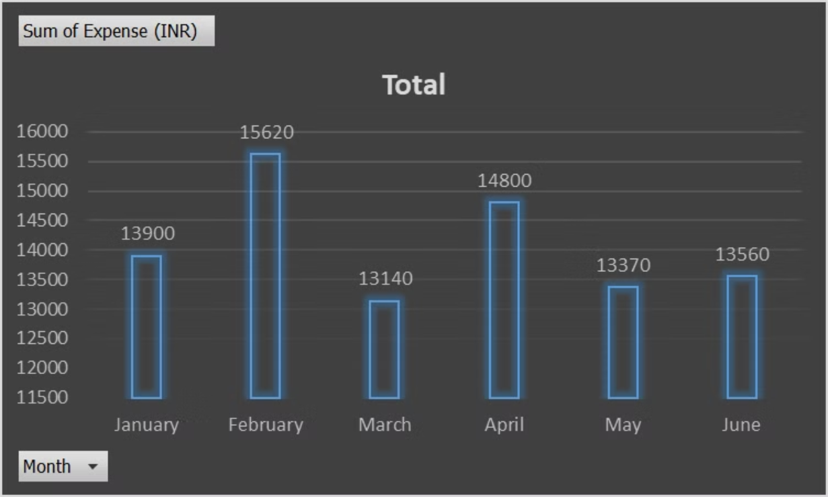
Visual Representation

Slide 14
Sum of Expenses
Category
Sum of Expense (INR)
Doctor and Medicine
4000
Entertainment
12000
Food
4940
Grocery
30990
Miscellaneous
7720
Shopping
8700
Ticket and Bills
16040
Grand Total
84390

Slide 15
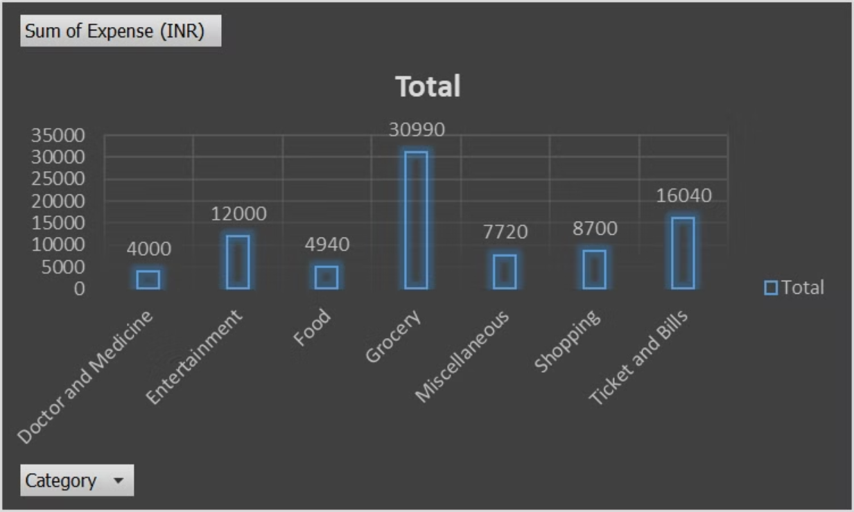
Visual Representation

Slide 16
Detailed View of 6 Month Expenses
Sum of Expense (INR)
Category
Months
Doctor and Medicine
Entertainment
Food
Grocery
Miscellaneous
Shopping
Ticket and Bills
Grand Total
January
1750
250
1900
4500
850
2000
2650
13900
February
450
7500
4300
720
2650
15620
March
450
500
800
6090
850
1700
2750
13140
April
450
1250
1390
5460
3500
2750
14800
May
450
1500
5950
1300
1500
2670
13370
June
450
1000
850
4690
500
3500
2570
13560
Grand Total
4000
12000
4940
30990
7720
8700
16040
84390

Slide 17
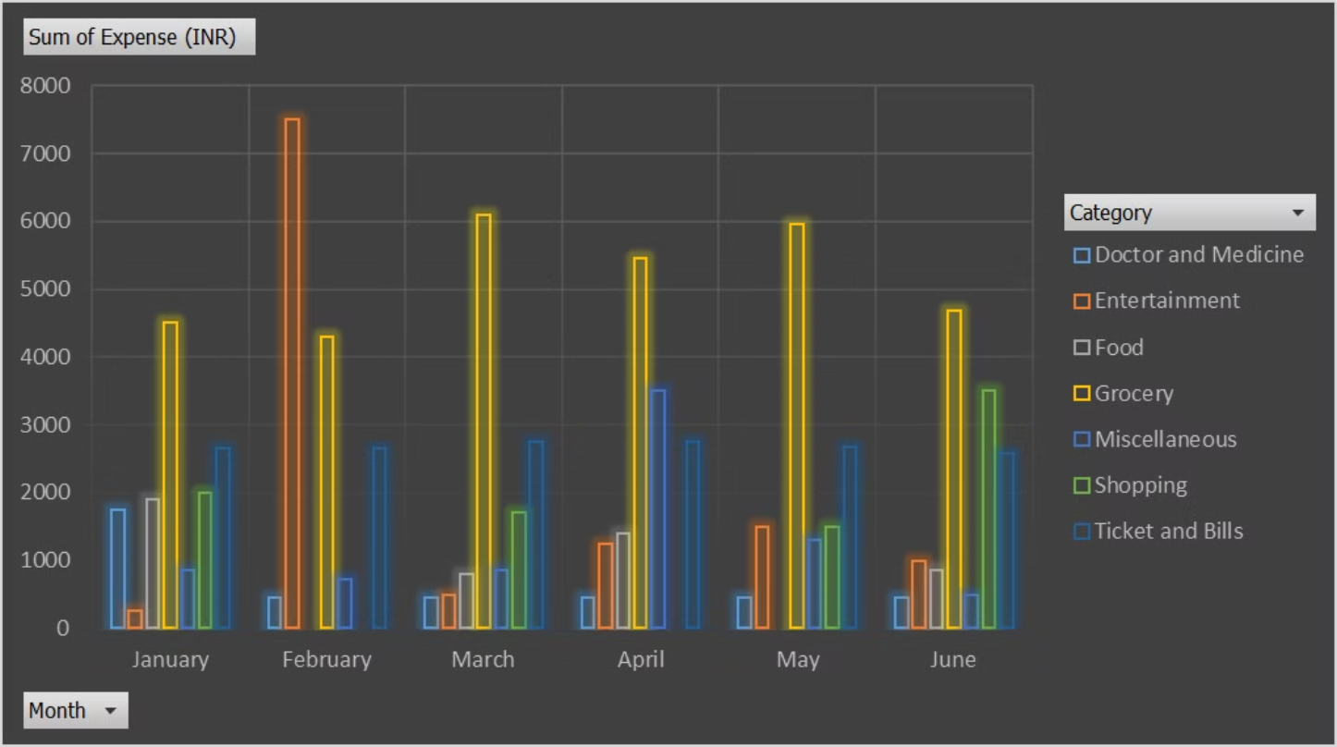
Visual Representation

Slide 18
Recommendations for Nitin to Increase Savings
Limit movie outings: Avoid going out for movie and explore free events instead.
Explore free activities: Discover local parks, museums, and cultural events.
Create a shopping list: Avoid impulse purchases by planning your shopping trips.
Review expenses: Carefully examine each item in the "Miscellaneous" category to identify unnecessary spending.
Reduce subscriptions: Cancel unused subscriptions or services.
Limit impulse purchases: Avoid buying items you don't truly need.
Buy in bulk: Purchase items in larger quantities to save money.
Avoid online order: Avoid online food orders.
Cook at home: Prepare meals instead of eating out frequently.
Conserve energy: Turn off lights and appliances when not in use.
Shop around for better rates: Compare offers from different providers.
Additional Tips:
Set a strict budget: Allocate a specific amount for each expense category.
Track your spending: Monitor your expenses regularly to identify areas where you can cut back.

Slide 19
THANK YOU

